Slide 1
Section 2.6 Inverse of Quadratic Functions
i) Concept of Inverse functions
ii) Domain and Range of the inverse of a QF
iii) Graphing the inverse of a QF
© Copyright all rights reserved to Homework depot: www.BCMath.ca

Slide 2
Inverse Functions
The inverse of a function will switch the X and Y variables and then isolate the Y variable afterwards
ie: Given the function, find its inverse:
Switch the two variables
Isolate the Y-variable
The inverse function is:
Graphically, the inverse of a function is a reflection over the line y=x
If the coordinate (a,b) is on y=f(x), then the coordinate (b,a) will be on the inverse function y=f ⁻¹(x)
© Copyright all rights reserved to Homework depot: www.BCMath.ca

Slide 3
Practice: Find the inverse function for each of the functions below

Slide 4
Ex: Given the graph of , Graph the inverse function
Suppose we have a TOV for the original function
New coordinates can be found by switching the X & Y coordinates
y
5
4
3
2
1
x
-4
-3
-2
-1
0
1
2
3
4
5
6
7
-1
-2
-3
-4
-5
© Copyright all rights reserved to Homework depot: www.BCMath.ca

Slide 5
Practice: Find the inverse of the following function and graph it.
y
5
4
3
2
1
x
-4
-3
-2
-1
0
1
2
3
4
5
6
7
-1
-2
-3
-4
-5
© Copyright all rights reserved to Homework depot: www.BCMath.ca

Slide 6
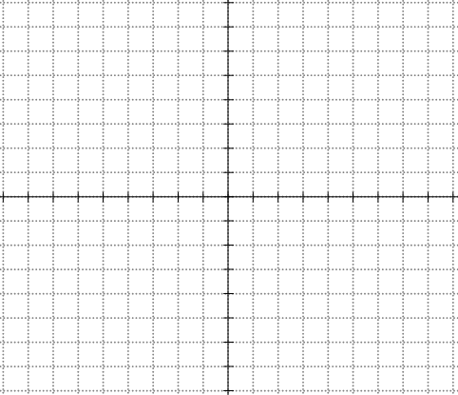
The Inverse of a Quadratic Function
The inverse of a QF is not a function because it does not pass the vertical line test
So we must split the QF to two separate domains with the axis of symmetry. When the QF is broken into 2 parts, the inverse of each part will be a function
The inverse of the right side is on top
The inverse of the left side is on bottom
Each graph is split along the axis of symmetry
© Copyright all rights reserved to Homework depot: www.BCMath.ca

Slide 7
Find the inverse of the following function:
The inverse of the right side of the parabola will be the top:
Switch “x” and “y”
Isolate “y”
The inverse of the left side of the parabola will be the bottom:
y
Square root both sides – plus or minus!
5
4
3
2
1
x
-4
-3
-2
-1
0
1
2
3
4
5
6
7
-1
-2
-3
© Copyright all rights reserved to Homework depot: www.BCMath.ca
-4
-5

Slide 8
Practice: Find the inverse function :
Switch “x” and “y”
Isolate the “y” variable
Take the negative square root because the domain is on the left side
Since we are looking for the inverse of the “left” side of the parabola, the inverse function will be the “bottom” side of the root function
© Copyright all rights reserved to Homework depot: www.BCMath.ca

Slide 9
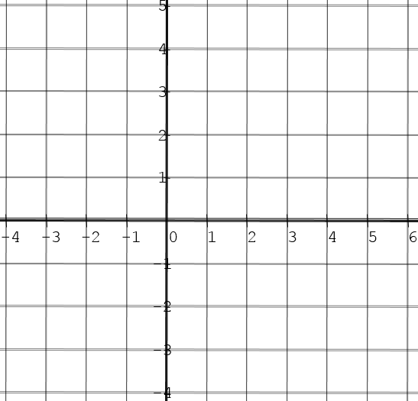
Given the following graphs, draw the graph of the inverse functions:

Slide 10
Domain & Range of the Inverse function:
Since we switch the x and y variables for the inverse, the domain of f(x) becomes the range of the inverse
Make sure you know which side of the domain that you are taking the inverse of
Likewise, the range of f(x) becomes the domain of the inverse
© Copyright all rights reserved to Homework depot: www.BCMath.ca

Slide 11
Ex: Find the inverse function and also the domain and Range of the inverse function
We’re taking the inverse of the right side of the parabola
The graph opens up with a minimum value
© Copyright all rights reserved to Homework depot: www.BCMath.ca

Slide 12
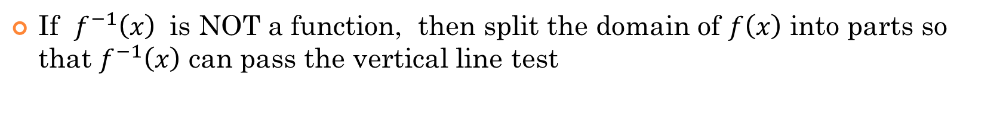
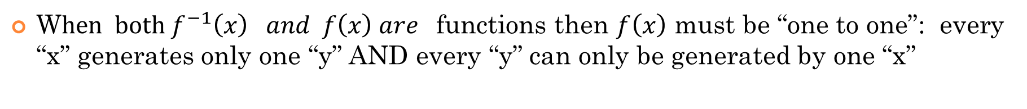
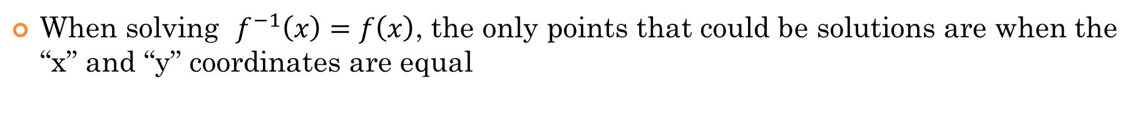
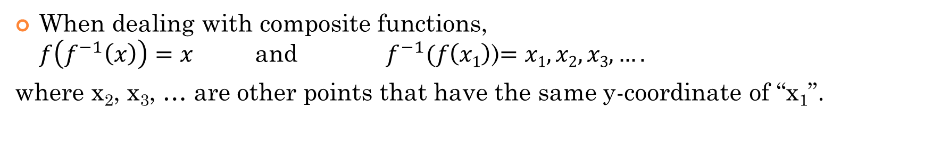
General Properties of Inverse Functions
If the point$\left(a,b\right) is on y=f\left(x\right), then f^{−1} (b)=a$
When dealing with composite functions, $f\left(f^{−1}\left(x\right)\right)=x$ and $f^{−1}(f\left(x1\right)$)$=x1, x2, x3,….$
where x₂, x₃, … are other points that have the same y-coordinate of “x₁”.
When solving $f^{−1}\left(x\right)=f\left(x\right)$, the only points that could be solutions are when the “x” and “y” coordinates are equal
W$hen both f^{−1}\left(x\right) and f\left(x\right) are$functions then $f\left(x\right)$ must be “one to one”: every “x” generates only one “y” AND every “y” can only be generated by one “x”
If $f^{−1}\left(x\right)$ is NOT a function, then split the domain of $f\left(x\right)$ into parts so that $f^{−1}\left(x\right)$ can pass the vertical line test

Slide 13
Given the function, find each of the following values
y
5
x
-5
0
5
-5
© Copyright all rights reserved to Homework depot: www.BCMath.ca

Slide 14
Given the function $y=f(x)$, for what values of “x” will $f\left(x\right)=f^{−1}(x)$
Solve the following equation:

